Slide 1
La Jolla Commons
Phase II Office Tower
San Diego, California
Alyssa Stangl | Structural Option
Faculty Advisor | Dr. Hanagan
Photos Provided Courtesy of HINES

Slide 2
La Jolla Commons Office Tower
Building Introduction
Building Introduction
Design Scenario and Proposed Solution
Gravity Redesign
Preliminary Vibrations and Layout
Beam and Column Designs
Final Vibrations Analysis
Lateral Redesign
Layout
Moment Frames
Shear Walls
Architecture Breadth
Construction Breadth
Conclusions
Location | San Diego, California – SDC D
13 Stories + Penthouse | 198’ – 8”
2 Levels | Underground parking
462,301 GSF
Design-Bid-Build
Construction Dates | April 2012 – May 2014
Building Cost | $78,000,000
San Diego, CA

Slide 3
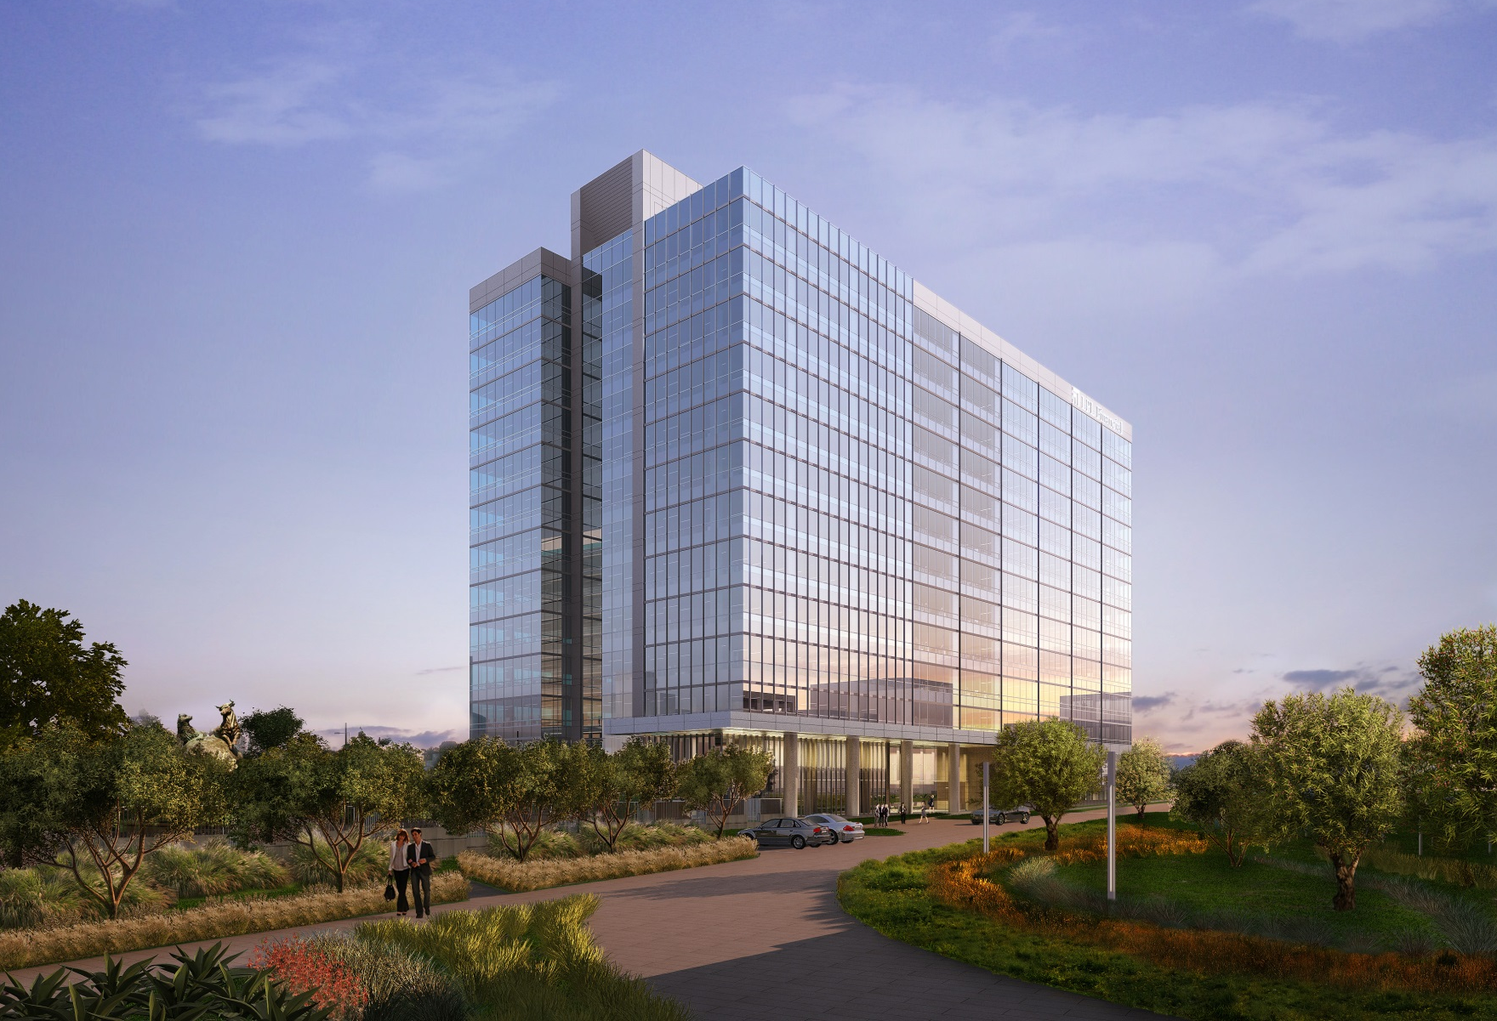
La Jolla Commons Office Tower
Project Team
Building Introduction
Design Scenario and Proposed Solution
Gravity Redesign
Preliminary Vibrations and Layout
Beam and Column Designs
Final Vibrations Analysis
Lateral Redesign
Layout
Moment Frames
Shear Walls
Architecture Breadth
Construction Breadth
Conclusions
Owner | Hines
Tenant | LPL Financial
Architect | AECOM
Structural Engineer | Nabih Youssef Associates
Photo Provided Courtesy of HINES

Slide 4
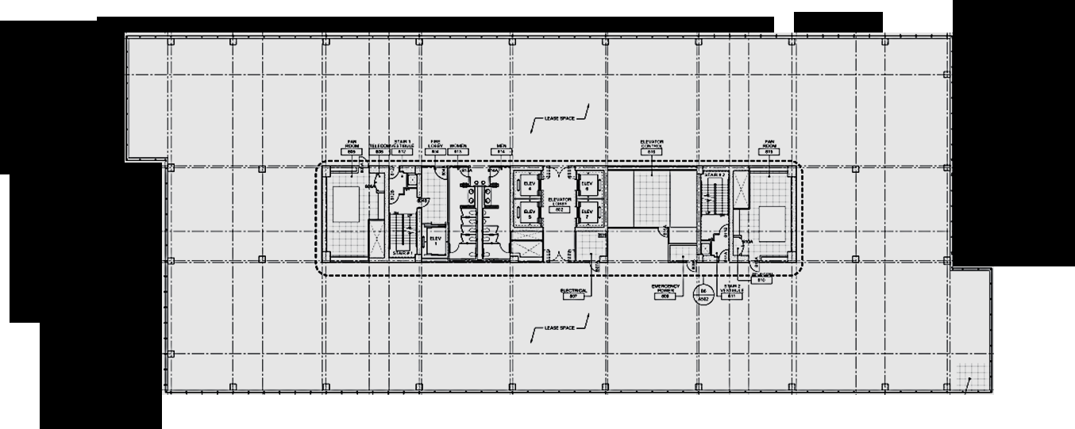
La Jolla Commons Office Tower
Architectural Overview
Building Introduction
Design Scenario and Proposed Solution
Gravity Redesign
Preliminary Vibrations and Layout
Beam and Column Designs
Final Vibrations Analysis
Lateral Redesign
Layout
Moment Frames
Shear Walls
Architecture Breadth
Construction Breadth
Conclusions
Large open floor plans
Office use only
Similar architecture to LJC Tower I
198’-8” height limited by FAA
LEED-CS Gold & NetZero
315’ – 0”
128 ‘ – 8”
N
Image from Project Documents Provided Courtesy of HINES

Slide 5
La Jolla Commons Office Tower
Architectural Overview
Building Introduction
Design Scenario and Proposed Solution
Gravity Redesign
Preliminary Vibrations and Layout
Beam and Column Designs
Final Vibrations Analysis
Lateral Redesign
Layout
Moment Frames
Shear Walls
Architecture Breadth
Construction Breadth
Conclusions
Image from Project Documents Provided Courtesy of HINES
Large open floor plans
Office use only
Similar architecture to LJC Tower I
198’-8” height limited by FAA
LEED-CS Gold & NetZero
N
Core – Elevators, Stairs, Mech
Office Space

Slide 6
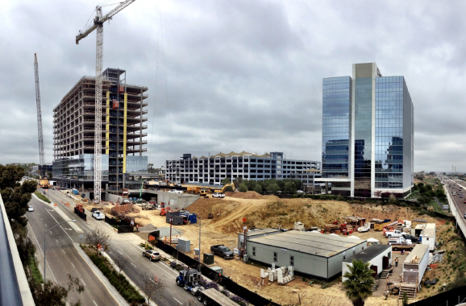
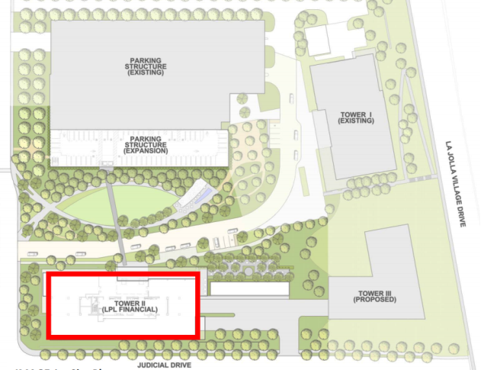
La Jolla Commons Office Tower
Architectural Overview
Photo Provided Courtesy of HINES
Building Introduction
Design Scenario and Proposed Solution
Gravity Redesign
Preliminary Vibrations and Layout
Beam and Column Designs
Final Vibrations Analysis
Lateral Redesign
Layout
Moment Frames
Shear Walls
Architecture Breadth
Construction Breadth
Conclusions
Large open floor plans
Office use only
Similar architecture to LJC Tower I
198’-8” height limited by FAA
LEED-CS Gold & NetZero
Tower I
Tower II

Slide 7
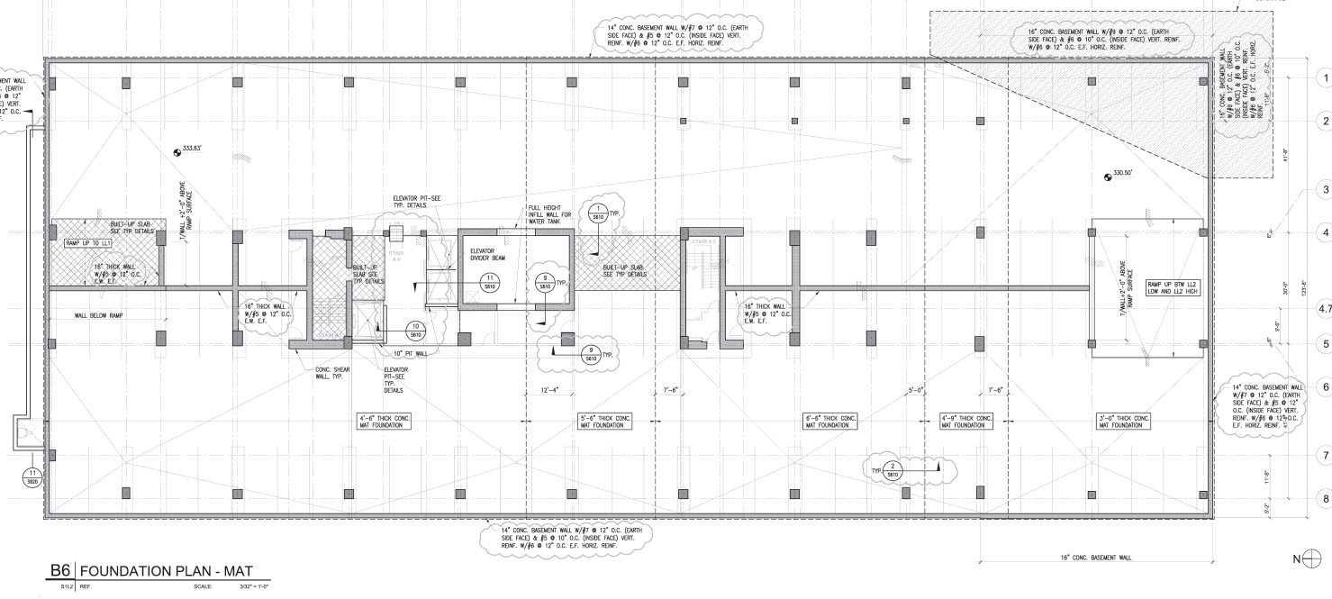
La Jolla Commons Office Tower
Existing Structural Overview
Image from Project Documents Provided Courtesy of HINES
Building Introduction
Design Scenario and Proposed Solution
Gravity Redesign
Preliminary Vibrations and Layout
Beam and Column Designs
Final Vibrations Analysis
Lateral Redesign
Layout
Moment Frames
Shear Walls
Architecture Breadth
Construction Breadth
Conclusions
Gravity System
Mat foundation
Floor System
Lateral System
Shear Walls
Collectors
N

Slide 8
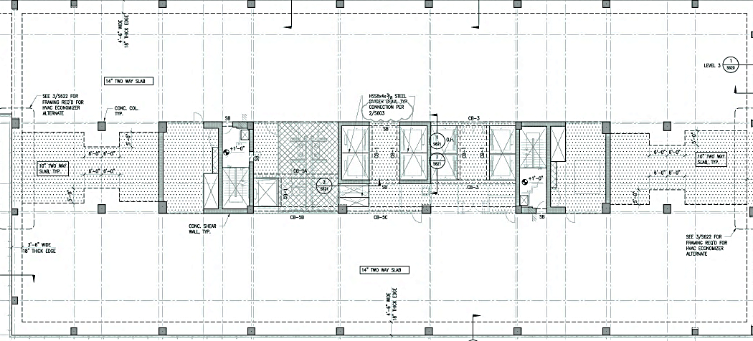
La Jolla Commons Office Tower
Existing Structural Overview
Image from Project Documents Provided Courtesy of HINES
Building Introduction
Design Scenario and Proposed Solution
Gravity Redesign
Preliminary Vibrations and Layout
Beam and Column Designs
Final Vibrations Analysis
Lateral Redesign
Layout
Moment Frames
Shear Walls
Architecture Breadth
Construction Breadth
Conclusions
Gravity System
Mat foundation
Floor System
Two-Way, Flat Plate Concrete Slab
10” – 14” Thickness
18” Spandrel Beam
Lateral System
Shear Walls
Collectors
N

Slide 9
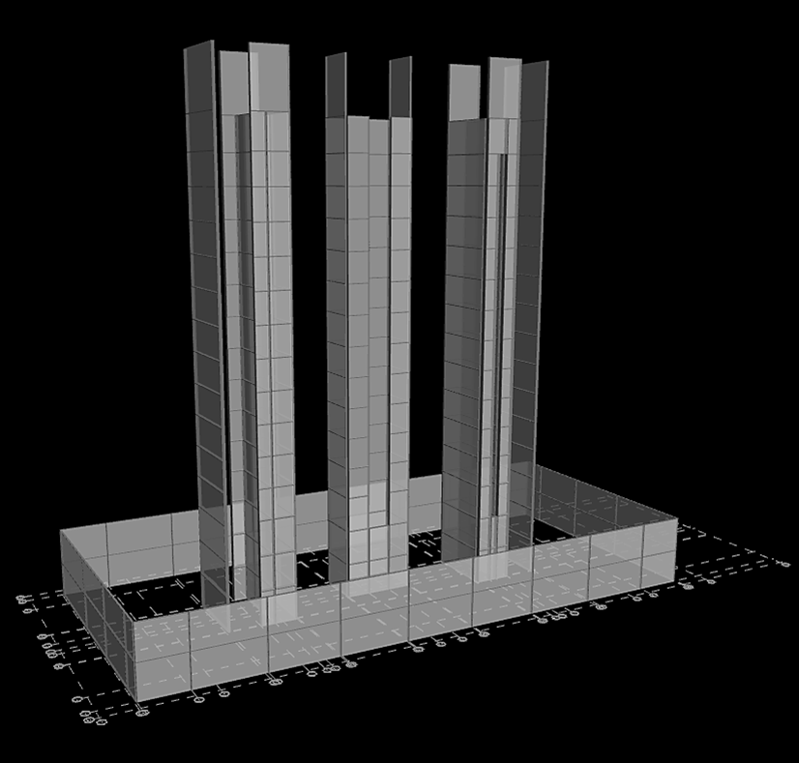
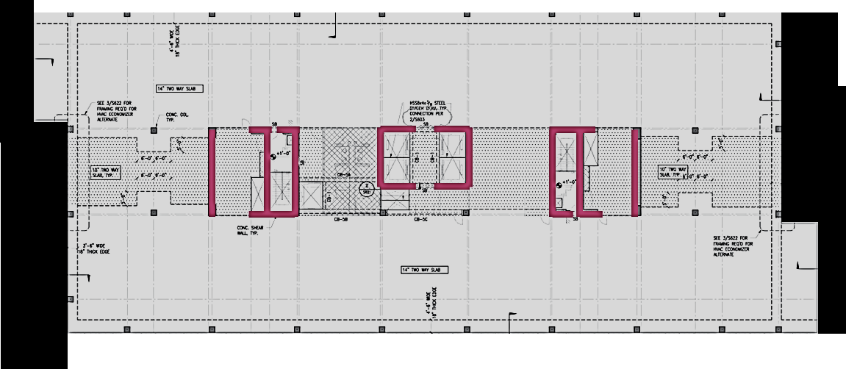
La Jolla Commons Office Tower
Existing Structural Overview
Building Introduction
Design Scenario and Proposed Solution
Gravity Redesign
Preliminary Vibrations and Layout
Beam and Column Designs
Final Vibrations Analysis
Lateral Redesign
Layout
Moment Frames
Shear Walls
Architecture Breadth
Construction Breadth
Conclusions
Gravity System
Foundation
Floor System
Lateral System
Shear Walls
Existing Torsional Irregularity
Collectors

Slide 10
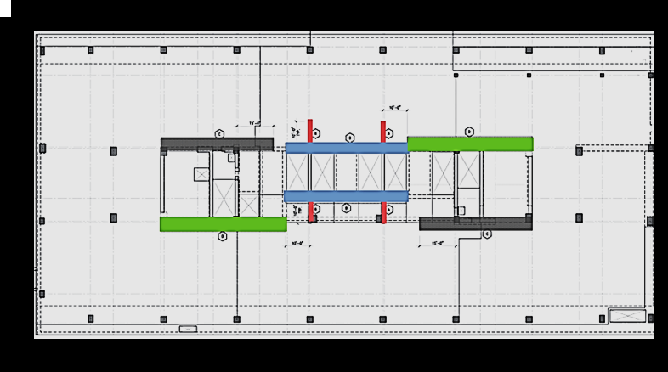
La Jolla Commons Office Tower
Existing Structural Overview
Building Introduction
Design Scenario and Proposed Solution
Gravity Redesign
Preliminary Vibrations and Layout
Beam and Column Designs
Final Vibrations Analysis
Lateral Redesign
Layout
Moment Frames
Shear Walls
Architecture Breadth
Construction Breadth
Conclusions
Image from Project Documents Provided Courtesy of HINES
Gravity System
Foundation
Floor System
Lateral System
Shear Walls
Collectors
N-S Direction at Lower Levels
N

Slide 11
La Jolla Commons Office Tower
Design Scenario
Proposed Solution
Building Introduction
Design Scenario and Proposed Solution
Gravity Redesign
Preliminary Vibrations and Layout
Beam and Column Designs
Final Vibrations Analysis
Lateral Redesign
Layout
Moment Frames
Shear Walls
Architecture Breadth
Construction Breadth
Conclusions
Redesign the building in steel
Modify lateral system to eliminate existing torsional irregularity
Determine Impact
Architecture
Serviceability – Walking induced vibrations
Cost and schedule
Use original column locations
Determine configuration of composite steel beams to control vibrations
Add steel moment frames to building perimeter to control torsion
Determine floor-to-ceiling height impact
Compare costs and schedules

Slide 12
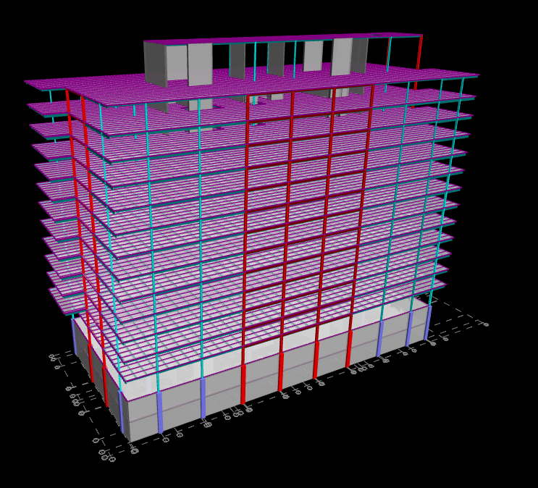
La Jolla Commons Office Tower
Building Introduction
Design Scenario and Proposed Solution
Gravity Redesign
Preliminary Vibrations Analysis and Layout
Beam and Column Designs
Final Vibrations Analysis
Lateral Redesign
Layout
Moment Frames
Shear Walls
Architecture Breadth
Construction Breadth
Conclusions
Gravity Redesign

Slide 13
La Jolla Commons Office Tower
Preliminary Vibrations Analysis
Deck Configuration for Vibration Control
Concrete Strength | 3000 psi
Steel Grade | 50
Deck Type | 1.5VLR20
Topping (in) | 4.25
LW/NW? | LW
Total Slab Thickness (in) | 5.75
Class | 4
Select C1 | 0.413
Select C2 | 0.019
Evaluate C1 + C2 | 0.432
C1 + C2 < 0.5? | GOOD
Building Introduction
Design Scenario and Proposed Solution
Gravity Redesign
Preliminary Vibrations Analysis and Layout
Beam and Column Designs
Final Vibrations Analysis
Lateral Redesign
Layout
Moment Frames
Shear Walls
Architecture Breadth
Construction Breadth
Conclusions
Vibrations due to human excitation
Control peak acceleration of the bay
Design Selection:
1.5VLR20
4.25” LW Topping
7.5’ – 8’ beam spacing
Source: The Preliminary Assessment for Walking-Induced Vibrations in Office Environments by Dr. Linda Hanagan and Taehoo Kim

Slide 14
La Jolla Commons Office Tower
Gravity System Layout
Building Introduction
Design Scenario and Proposed Solution
Gravity Redesign
Preliminary Vibrations Analysis and Layout
Beam and Column Designs
Final Vibrations Analysis
Lateral Redesign
Layout
Moment Frames
Shear Walls
Architecture Breadth
Construction Breadth
Conclusions
Which direction to span infill beams?
Short
Long
Long Direction Selected

Slide 15
La Jolla Commons Office Tower
Gravity System Layout
Building Introduction
Design Scenario and Proposed Solution
Gravity Redesign
Preliminary Vibrations Analysis and Layout
Beam and Column Designs
Final Vibrations Analysis
Lateral Redesign
Layout
Moment Frames
Shear Walls
Architecture Breadth
Construction Breadth
Conclusions
Which direction to span infill beams?
Short
Long
Long Direction Selected

Slide 16
La Jolla Commons Office Tower
Gravity System Layout
Building Introduction
Design Scenario and Proposed Solution
Gravity Redesign
Preliminary Vibrations Analysis and Layout
Beam and Column Designs
Final Vibrations Analysis
Lateral Redesign
Layout
Moment Frames
Shear Walls
Architecture Breadth
Construction Breadth
Conclusions
Which direction to span infill beams?
Short
Long
Long Direction Selected
Infill Beam Comparison
 | Steel Weight (lbs) | Number of Members
Long Direction | 212936 | 155
Short Direction | 179608 | 225

Slide 17
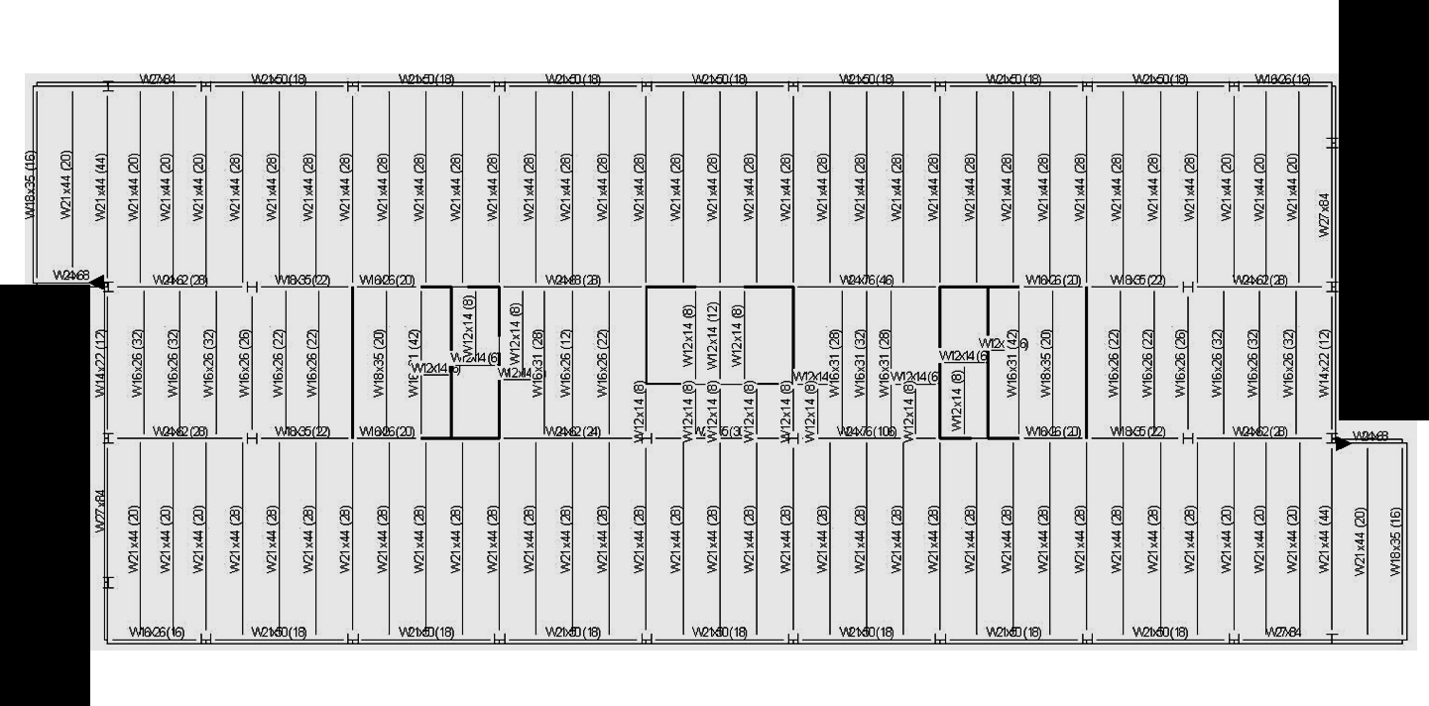
La Jolla Commons Office Tower
Gravity System Layout
Building Introduction
Design Scenario and Proposed Solution
Gravity Redesign
Preliminary Vibrations Analysis and Layout
Beam and Column Designs
Final Vibrations Analysis
Lateral Redesign
Layout
Moment Frames
Shear Walls
Architecture Breadth
Construction Breadth
Conclusions
N

Slide 18
La Jolla Commons Office Tower
RAM Gravity Model
Building Introduction
Design Scenario and Proposed Solution
Gravity Redesign
Preliminary Vibrations Analysis and Layout
Beam and Column Designs
Final Vibrations Analysis
Lateral Redesign
Layout
Moment Frames
Shear Walls
Architecture Breadth
Construction Breadth
Conclusions
RAM SS used to develop gravity designs
Composite steel beams
Steel columns
Several designs verified by hand calculations
Gravity Loads
 | Dead (PSF) | Live (PSF)
Core | 90 | 250
Lease Space | 90 | 80

Slide 19
La Jolla Commons Office Tower
Beam Designs
Building Introduction
Design Scenario and Proposed Solution
Gravity Redesign
Preliminary Vibrations Analysis and Layout
Beam and Column Designs
Final Vibrations Analysis
Lateral Redesign
Layout
Moment Frames
Shear Walls
Architecture Breadth
Construction Breadth
Conclusions
Common Member Sizes:
W21x44 (28) infill exterior bays
W24x62 (32) infill interior bays
W21x50 (18) exterior girder
N

Slide 20
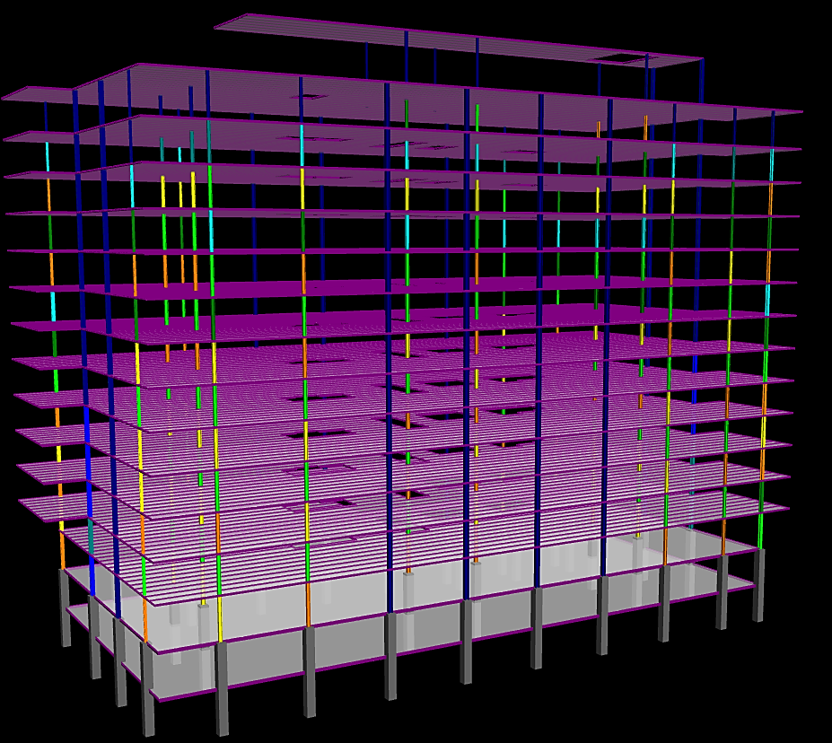
La Jolla Commons Office Tower
Column Designs
Building Introduction
Design Scenario and Proposed Solution
Gravity Redesign
Preliminary Vibrations Analysis and Layout
Beam and Column Designs
Final Vibrations Analysis
Lateral Redesign
Layout
Moment Frames
Shear Walls
Architecture Breadth
Construction Breadth
Conclusions
Spliced every 2 stories
Each column line has consistent column depth

Slide 21
La Jolla Commons Office Tower
Column Designs
Building Introduction
Design Scenario and Proposed Solution
Gravity Redesign
Preliminary Vibrations Analysis and Layout
Beam and Column Designs
Final Vibrations Analysis
Lateral Redesign
Layout
Moment Frames
Shear Walls
Architecture Breadth
Construction Breadth
Conclusions
Spliced every 2 stories
Each column line has consistent column depth
Exterior Column Line
W10X33
W10X88

Slide 22
La Jolla Commons Office Tower
Column Designs
Building Introduction
Design Scenario and Proposed Solution
Gravity Redesign
Preliminary Vibrations Analysis and Layout
Beam and Column Designs
Final Vibrations Analysis
Lateral Redesign
Layout
Moment Frames
Shear Walls
Architecture Breadth
Construction Breadth
Conclusions
Spliced every 2 stories
Each column line has consistent column depth
Exterior Column Line
Interior Column Line
W14X43
W14X193

Slide 23
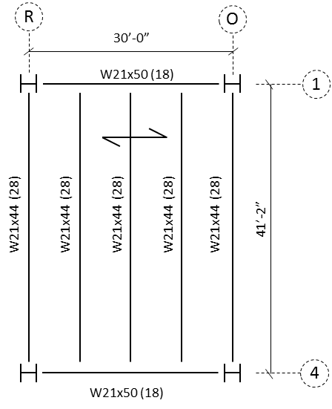
La Jolla Commons Office Tower
Final Vibrations Analysis
Building Introduction
Design Scenario and Proposed Solution
Gravity Redesign
Preliminary Vibrations Analysis and Layout
Beam and Column Designs
Final Vibrations Analysis
Lateral Redesign
Layout
Moment Frames
Shear Walls
Architecture Breadth
Construction Breadth
Conclusions
AISC Design Guide 11 analysis on a typical bay for walking induced vibrations
Determine combined panel weight and natural frequency to determine bay peak acceleration
P₀ = 65 lb
$β$ = 0.03
a₀/g < 0.5%
$\frac{a_{0}}{g}≥\frac{a_{p}}{g} →0.5\% ≥0.38\%$
From AISC DG 11 – Table 4.1

Slide 24
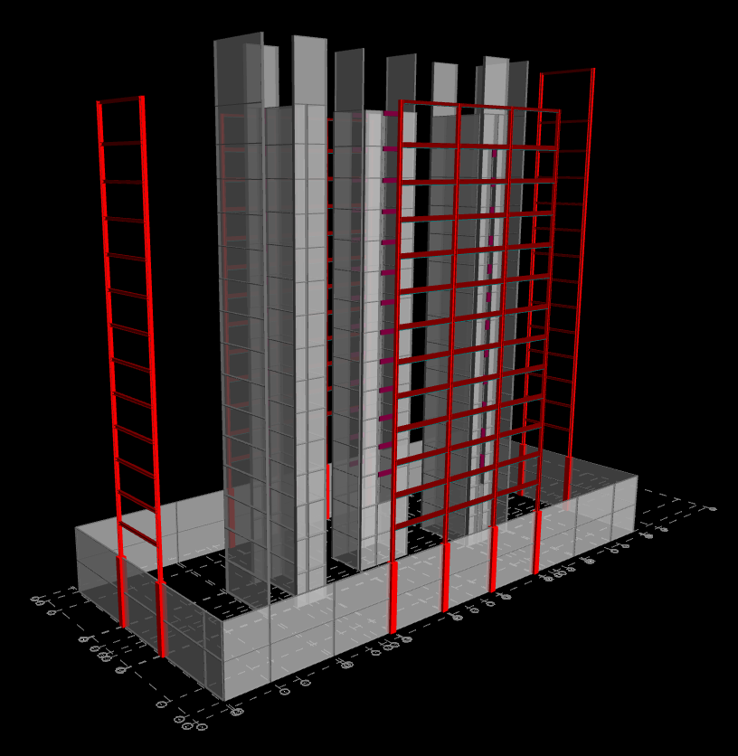
La Jolla Commons Office Tower
Building Introduction
Design Scenario and Proposed Solution
Gravity Redesign
Preliminary Vibrations Analysis and Layout
Beam and Column Designs
Final Vibrations Analysis
Lateral Redesign
Layout
Moment Frames
Shear Walls
Architecture Breadth
Construction Breadth
Conclusions
Lateral Redesign

Slide 25
La Jolla Commons Office Tower
Lateral System
Building Introduction
Design Scenario and Proposed Solution
Gravity Redesign
Preliminary Vibrations Analysis and Layout
Beam and Column Designs
Final Vibrations Analysis
Lateral Redesign
Layout
Moment Frames
Shear Walls
Architecture Breadth
Construction Breadth
Conclusions
Reduced building weight
→ Seismic loads decreased
Building height unchanged
→ Wind loads unchanged
Seismic controls
Base Shear (Kip)
 | Wind N-S | Wind E-W | Seismic N-S | Seismic E-W
Concrete | 583 | 1615 | 7698 | 7698
Steel | 583 | 1615 | 4935 | 4408

Slide 26
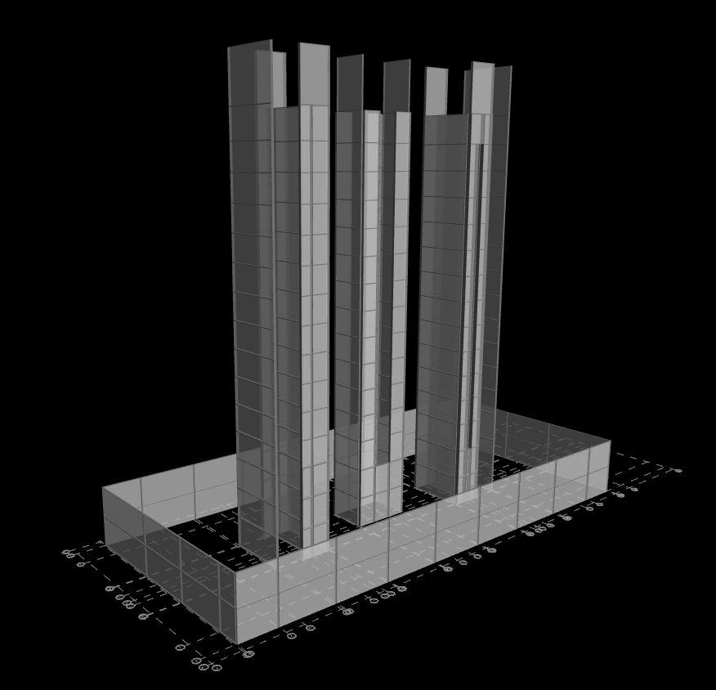
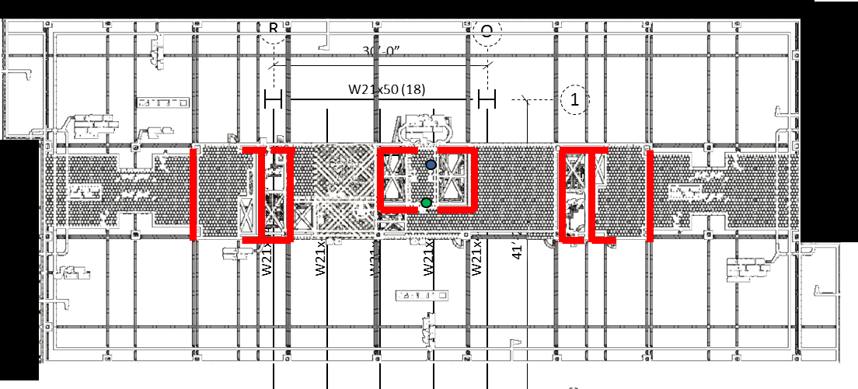
La Jolla Commons Office Tower
Existing Lateral System Layout
Building Introduction
Design Scenario and Proposed Solution
Gravity Redesign
Preliminary Vibrations Analysis and Layout
Beam and Column Designs
Final Vibrations Analysis
Lateral Redesign
Layout
Moment Frames
Shear Walls
Architecture Breadth
Construction Breadth
Conclusions
COR
Eccentricity = 10’
COM
N

Slide 27
La Jolla Commons Office Tower
New Lateral System Layout
Building Introduction
Design Scenario and Proposed Solution
Gravity Redesign
Preliminary Vibrations Analysis and Layout
Beam and Column Designs
Final Vibrations Analysis
Lateral Redesign
Layout
Moment Frames
Shear Walls
Architecture Breadth
Construction Breadth
Conclusions
COR
Eccentricity = 1’
COM
N

Slide 28
La Jolla Commons Office Tower
RAM Model
Building Introduction
Design Scenario and Proposed Solution
Gravity Redesign
Preliminary Vibrations Analysis and Layout
Beam and Column Designs
Final Vibrations Analysis
Lateral Redesign
Layout
Moment Frames
Shear Walls
Architecture Breadth
Construction Breadth
Conclusions
Rigid diaphragms
Wall shell elements neglect out of plane stiffness
Stiffness reduction based on ACI 318-11
Panel zone deformations considered
Base constraints

Slide 29
La Jolla Commons Office Tower
Special Moment Frames
Building Introduction
Design Scenario and Proposed Solution
Gravity Redesign
Preliminary Vibrations Analysis and Layout
Beam and Column Designs
Final Vibrations Analysis
Lateral Redesign
Layout
Moment Frames
Shear Walls
Architecture Breadth
Construction Breadth
Conclusions
Special moment frames required by ASCE 7-10
SDC D
198’ > 65’
Designed to be “clean column”
Strong panel zone
Strength and joint optimizations for seismic

Slide 30
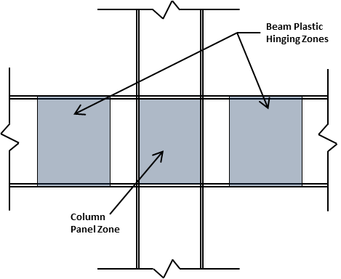
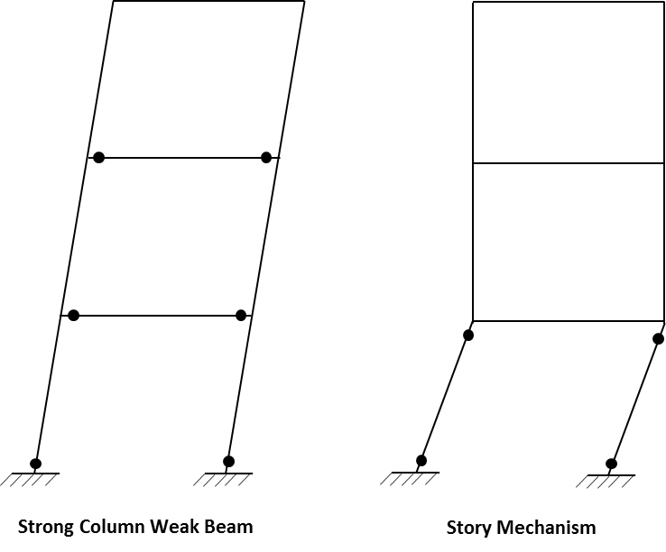
La Jolla Commons Office Tower
Special Moment Frames
Building Introduction
Design Scenario and Proposed Solution
Gravity Redesign
Preliminary Vibrations Analysis and Layout
Beam and Column Designs
Final Vibrations Analysis
Lateral Redesign
Layout
Moment Frames
Shear Walls
Architecture Breadth
Construction Breadth
Conclusions
$$\frac{\sum{M_{pc}^{∗}}}{\sum{M_{pb}^{∗}}}>1.0 (Provisions Eq. E3)$$
Notes:
Special attention to connection detailing
No openings in beam at hinge locations
Force elasticity into beams – Strong Panel Zone
Connection design
Reduce beam section at hinge zone
75% of elastic deformation in beam hinges
Requirements for Highly Ductile members

Slide 31
La Jolla Commons Office Tower
Special Moment Frames
Building Introduction
Design Scenario and Proposed Solution
Gravity Redesign
Preliminary Vibrations Analysis and Layout
Beam and Column Designs
Final Vibrations Analysis
Lateral Redesign
Layout
Moment Frames
Shear Walls
Architecture Breadth
Construction Breadth
Conclusions
FRAME 1
Levels 3-5

Slide 32
La Jolla Commons Office Tower
Special Concrete Shear Walls
Building Introduction
Design Scenario and Proposed Solution
Gravity Redesign
Preliminary Vibrations Analysis and Layout
Beam and Column Designs
Final Vibrations Analysis
Lateral Redesign
Layout
Moment Frames
Shear Walls
Architecture Breadth
Construction Breadth
Conclusions
Thickness not reduced to control drift
Reinforcing redesigned for reduced loads
According to ACI 318-11 Ch. 21

Slide 33
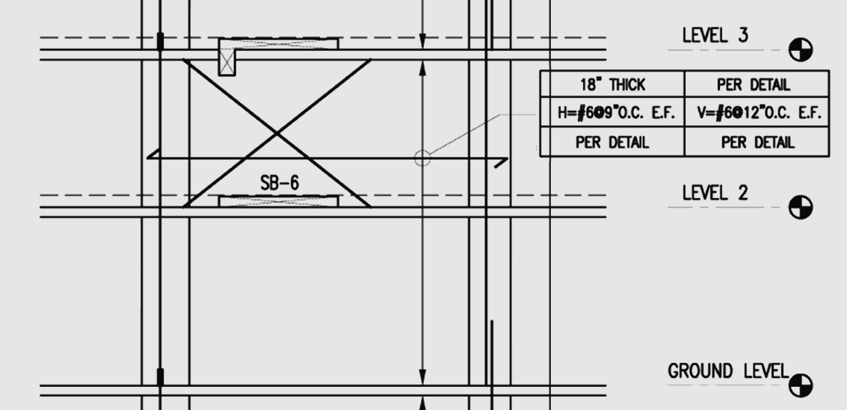
La Jolla Commons Office Tower
Special Concrete Shear Walls
Building Introduction
Design Scenario and Proposed Solution
Gravity Redesign
Preliminary Vibrations Analysis and Layout
Beam and Column Designs
Final Vibrations Analysis
Lateral Redesign
Layout
Moment Frames
Shear Walls
Architecture Breadth
Construction Breadth
Conclusions
Shear Wall U Level 2– Reinforcing redesign
7000 PSI NW Concrete, 18” Thick
H = #6 @ 9” O.C.
V = #6 @ 9” O.C.
One curtain only
Image from Project Documents Provided Courtesy of HINES

Slide 34
La Jolla Commons Office Tower
Building Introduction
Design Scenario and Proposed Solution
Gravity Redesign
Preliminary Vibrations Analysis and Layout
Beam and Column Designs
Final Vibrations Analysis
Lateral Redesign
Layout
Moment Frames
Shear Walls
Architecture Breadth
Construction Breadth
Conclusions
Architecture Breadth
Photo Provided Courtesy of HINES

Slide 35
La Jolla Commons Office Tower
Floor-to-Ceiling Height
Building Introduction
Design Scenario and Proposed Solution
Gravity Redesign
Preliminary Vibrations Analysis and Layout
Beam and Column Designs
Final Vibrations Analysis
Lateral Redesign
Layout
Moment Frames
Shear Walls
Architecture Breadth
Construction Breadth
Conclusions
Building height limited to 198’-8” by FAA
Steel creates a deeper structural system than concrete
Loss of floor-to-ceiling space
198’ – 8”
Photo Provided Courtesy of HINES

Slide 36
La Jolla Commons Office Tower
Floor-to-Ceiling Height
Building Introduction
Design Scenario and Proposed Solution
Gravity Redesign
Preliminary Vibrations Analysis and Layout
Beam and Column Designs
Final Vibrations Analysis
Lateral Redesign
Layout
Moment Frames
Shear Walls
Architecture Breadth
Construction Breadth
Conclusions
10’-8”
9’-2”
1’-6” Decrease in floor-to-ceiling height
Concrete
Steel

Slide 37
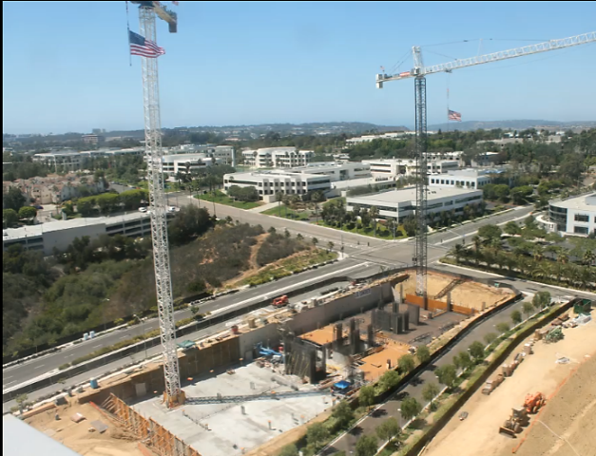
La Jolla Commons Office Tower
Building Introduction
Design Scenario and Proposed Solution
Gravity Redesign
Preliminary Vibrations Analysis and Layout
Beam and Column Designs
Final Vibrations Analysis
Lateral Redesign
Layout
Moment Frames
Shear Walls
Architecture Breadth
Construction Breadth
Conclusions
Construction Breadth
Photo Provided Courtesy of HINES

Slide 38
La Jolla Commons Office Tower
Concrete System Cost
Building Introduction
Design Scenario and Proposed Solution
Gravity Redesign
Preliminary Vibrations Analysis and Layout
Beam and Column Designs
Final Vibrations Analysis
Lateral Redesign
Layout
Moment Frames
Shear Walls
Architecture Breadth
Construction Breadth
Conclusions
Cost information provided by Hines
Concrete chosen because it was cheaper than steel system
Approximately $61 per SF
Original Concrete Structure Cost Summary
Cost Per SF | $ 61.46
Structural Square Footage | 462,301 SF
% General Conditions | 14%
Total Original Structure Cost | $ 28,413,000
General Conditions Cost | $ 3,978,000
Original Structure Cost w/ out General Conditions | $ 24,435,000

Slide 39
La Jolla Commons Office Tower
Steel System Cost
Building Introduction
Design Scenario and Proposed Solution
Gravity Redesign
Preliminary Vibrations Analysis and Layout
Beam and Column Designs
Final Vibrations Analysis
Lateral Redesign
Layout
Moment Frames
Shear Walls
Architecture Breadth
Construction Breadth
Conclusions
Total Steel Structure Cost (2009 RS Means)
Item | Cost
Concrete on Metal Deck | $ 3,050,000
Structural Steel Framing | $ 9,052,000
Shear Walls | $ 4,310,000
Foundation Walls | $ 1,929,000
Lower Level Concrete Slabs | $ 2,796,000
Lower Level Concrete Columns | $ 198,000
Mat Foundation | $ 4,055,000
Total Cost | $ 25,391,000
Final Modified Cost | $ 30,072,000
Based on cost information from RS Means 2009
Approximately $65 per SF

Slide 40
La Jolla Commons Office Tower
Cost Comparison
Building Introduction
Design Scenario and Proposed Solution
Gravity Redesign
Preliminary Vibrations Analysis and Layout
Beam and Column Designs
Final Vibrations Analysis
Lateral Redesign
Layout
Moment Frames
Shear Walls
Architecture Breadth
Construction Breadth
Conclusions
23 % Increase in cost for steel system
Validates original decision by designers to design structure in concrete
Final Cost Comparison
Original Concrete Structure Cost | $ 24,435,000
New Steel Structure Cost | $ 30,072,000
% Increase in Cost | 23%

Slide 41
La Jolla Commons Office Tower
Concrete System Schedule
Building Introduction
Design Scenario and Proposed Solution
Gravity Redesign
Preliminary Vibrations Analysis and Layout
Beam and Column Designs
Final Vibrations Analysis
Lateral Redesign
Layout
Moment Frames
Shear Walls
Architecture Breadth
Construction Breadth
Conclusions
Schedule information provided by Hines
Superstructure duration | 240 days
Image Extracted from Project Schedule Provided Courtesy of HINES

Slide 42
La Jolla Commons Office Tower
Steel System Schedule
Building Introduction
Design Scenario and Proposed Solution
Gravity Redesign
Preliminary Vibrations Analysis and Layout
Beam and Column Designs
Final Vibrations Analysis
Lateral Redesign
Layout
Moment Frames
Shear Walls
Architecture Breadth
Construction Breadth
Conclusions
Schedule produced in Microsoft Project
Durations from RS Means 2009
Superstructure duration | 230 days

Slide 43
La Jolla Commons Office Tower
Schedule Comparison
Building Introduction
Design Scenario and Proposed Solution
Gravity Redesign
Preliminary Vibrations Analysis and Layout
Beam and Column Designs
Final Vibrations Analysis
Lateral Redesign
Layout
Moment Frames
Shear Walls
Architecture Breadth
Construction Breadth
Conclusions
Only 2 weeks time savings
Not worth the 23% cost increase
If time savings were more significant, cost increase may have been offset

Slide 44
La Jolla Commons Office Tower
Conclusions
Building Introduction
Design Scenario and Proposed Solution
Gravity Redesign
Preliminary Vibrations Analysis and Layout
Beam and Column Designs
Final Vibrations Analysis
Lateral Redesign
Layout
Moment Frames
Shear Walls
Architecture Breadth
Construction Breadth
Conclusions
Designed a feasible steel gravity system with vibration reducing characteristics
Designed special steel moment frames
Eliminated torsional irregularity
Reduced floor-to-ceiling heights
Increased cost for steel structure is not offset by reduction in project schedule
Photo Provided Courtesy of HINES

Slide 45
La Jolla Commons Office Tower
Acknowledgements
Building Introduction
Design Scenario and Proposed Solution
Gravity Redesign
Preliminary Vibrations Analysis and Layout
Beam and Column Designs
Final Vibrations Analysis
Lateral Redesign
Layout
Moment Frames
Shear Walls
Architecture Breadth
Construction Breadth
Conclusions
Special Thanks to:
Hines
Nabih Youssef Associates
AE Faculty | especially Dr. Linda Hanagan & Prof. Sustersic
Benjamin Barben
My loving family, boyfriend, friends, and classmates
Photo Provided Courtesy of HINES

Slide 46
La Jolla Commons Office Tower
Building Introduction
Design Scenario and Proposed Solution
Gravity Redesign
Preliminary Vibrations Analysis and Layout
Beam and Column Designs
Final Vibrations Analysis
Lateral Redesign
Layout
Moment Frames
Shear Walls
Architecture Breadth
Construction Breadth
Conclusions
Questions and Comments?
Photo Provided Courtesy of HINES

Slide 47
La Jolla Commons Office Tower
Appendix Slides
Architecture Breadth
Dual Systems Check
Shear Wall Modeling
Lateral System Verification
Model Verification
Vibrations Analysis

Slide 48
La Jolla Commons Office Tower
Architecture Breadth
Appendix List

Slide 49
La Jolla Commons Office Tower
Floor-to-Ceiling Height
Building height limited to 198’-8” by FAA
Steel creates a deeper structural system than concrete
Loss of floor-to-ceiling space
198’ – 8”
Appendix List

Slide 50
La Jolla Commons Office Tower
Floor-to-Ceiling Height
1’-6” Decrease in floor-to-ceiling height
Appendix List
Concrete
Steel

Slide 51
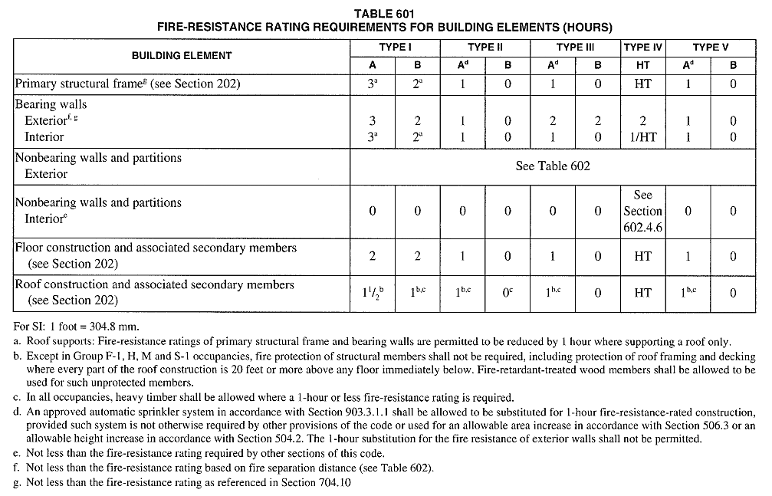
La Jolla Commons Office Tower
Fire Protection Breadth
Required Fire-Resistance Ratings
Element | Construction Type | Required Rating (hours)
Primary Floor Framing Members | Type 1B | 2
Secondary Floor Framing Members | Type 1B | 2
Structural Columns | Type 1A | 3
Appendix List

Slide 52
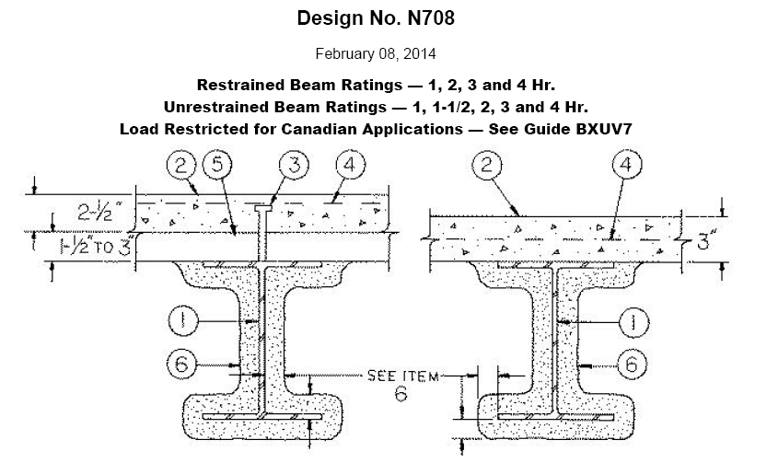
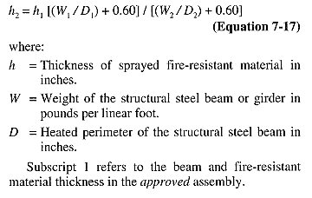
La Jolla Commons Office Tower
Fire Protection Breadth
Required Spray Fireproofing Thickness
722.5.2.2.1 Requirements
Min W/D for Substitute Beam: | 0.37 | OK
Min Thickness of Protection: | 0.375 | in
Unrestrained/restrained? | Unrestrained (to be conservative)
Min Fire Rating: | 1 hour
Required Fire Rating: | 2 hour
Minimum Beam Size: | W12x14
Heated Perimeter: | 0.405
Assembly Tested | Min Beam Size | h1 | W1/D1 | W2/D2 | h2
N708 | W8x28 | 1.00 | 0.819 | 0.405 | 1.412
Appendix List
1.5” of SFRM

Slide 53
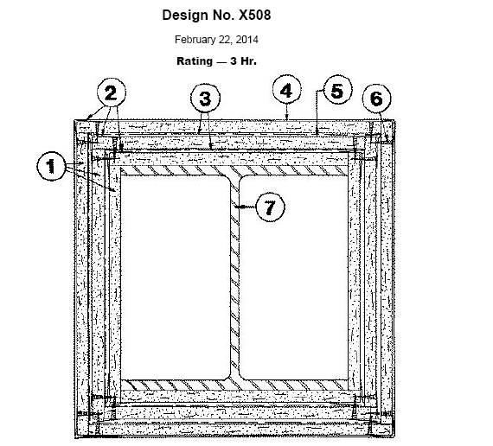
La Jolla Commons Office Tower
Fire Protection Breadth
1. The outer layer must be 5/8 inches thick. The inner layers will be 5/8 inch thick wall board as well. The wallboard is
installed without any horizontal joints. 1 inch long self-drilling screws shall be spaced as required for the installation of
the first layer of wall board.
2. 28 MSG galvanized metal corner bead
3. 18 SWG annealed wire, space 6 inches from each end and at 1’-9” intervals
4. May be finished with 3/32” thick gypsum veneer plaster. Joints reinforced.
5. Laminated with joint cement.
6. 1 inch long self-drilling screws spaced at 12” center to center
7. Minimum column size of W10X49. 9/16 flange thickness and 5/16 inch web thickness. 14.4 square inch area.
Appendix List

Slide 54
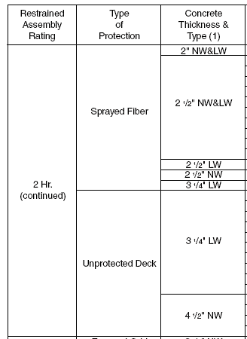
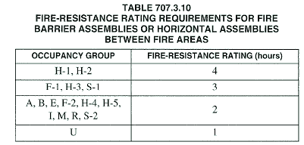
La Jolla Commons Office Tower
Fire Protection Breadth
4.25 LW topping provided
Adequate for 2 hour fire resistance between levels
Appendix List
Figure 3.2 - 7 | Resistance between Occupancies – IBC 2012 Table 707.3.10

Slide 55
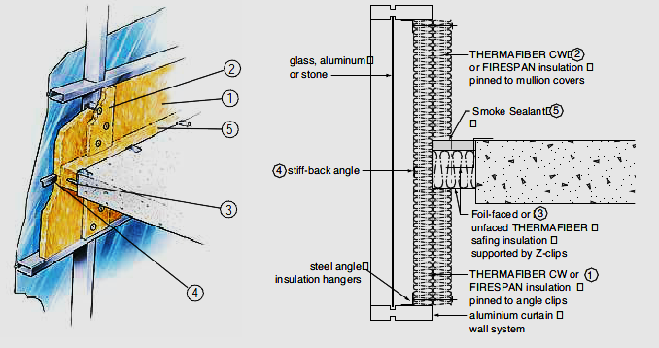
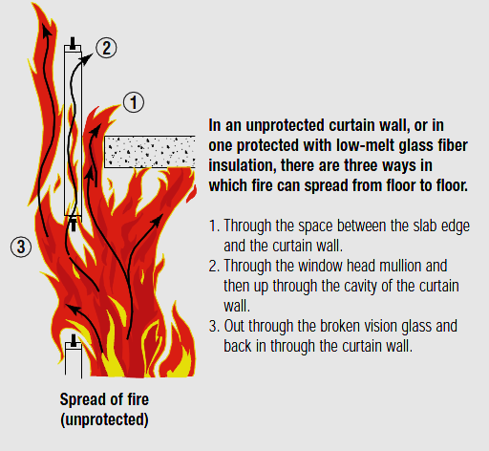
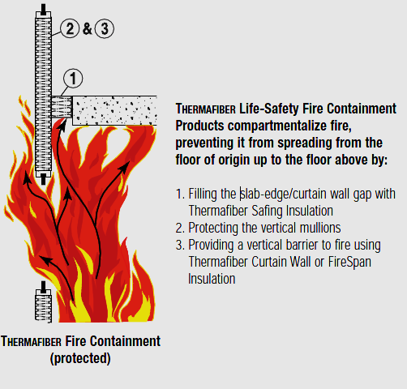
La Jolla Commons Office Tower
Fire Protection Breadth
Appendix List

Slide 56
La Jolla Commons Office Tower
Shear Wall Modeling
Appendix List

Slide 57
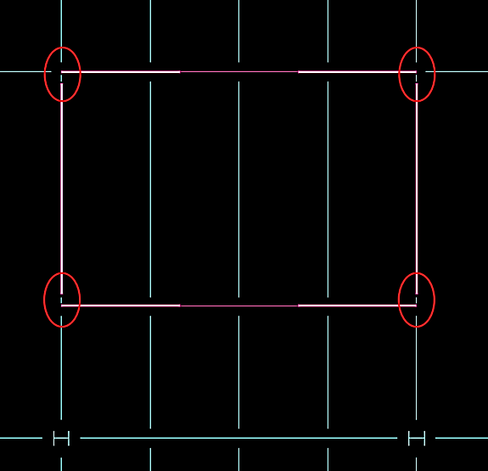
La Jolla Commons Office Tower
Shear Wall Modeling Method
Shell elements connected at nodes caused an irregular distribution of torsional forces within the wall core
Bentley suggested disconnecting the shear walls and adding gravity framing elements to eliminate a “framing tables” error
Does not count on flanged walls to take out of plane loads or to help in flexure
Eliminated odd torsionally anomaly
Appendix List

Slide 58
La Jolla Commons Office Tower
Model Verification
Appendix List

Slide 59
La Jolla Commons Office Tower
Model Verification
Model Verification Summary
 | % Error X-Direction | % Error Y-Direction
Center of Mass | 0.284% | 1.265%
Center of Rigidity | 2.813% | 1.681%
Floor Mass | 11%
Seismic Loads | 15%
Wind Loads | 0.25% | 3.31%
2D Analysis | 10 - 20 %
Appendix List

Slide 60
La Jolla Commons Office Tower
Dual System Check
Appendix List

Slide 61
La Jolla Commons Office Tower
Dual System Check
Dual System Check
X-Direction Direct Shear
Item | Shear (kip) | % of Total Shear | Dual System?
Frame 1 | 595.21 | 18.27% | No
Frame 2 | 643.37 | 19.74% | No
Shear Walls | 2020.00 | 61.99% | -
Total Shear | 3258.58 kip
Y-Direction Direct Shear
Item | Shear (kip) | % of Total Shear | Dual System?
Frame 3 | 35.61 | 1.18% | No
Frame 4 | 32.41 | 1.08% | No
Shear Walls | 2941.00 | 97.74% | -
Total Shear | 3009.02 kip
Appendix List

Slide 62
La Jolla Commons Office Tower
Lateral System Verification
Appendix List

Slide 63
La Jolla Commons Office Tower
Lateral System Verification
Drifts for wind and seismic were verified to meet code and industry standard requirements (Cd=5, R=6)
Torsional analysis was performed at each story under the different seismic load cases and found to no longer have an irregularity
Stability coefficients were verified
Overturning moment was checked under the controlling load case
Wind Displacement Determination
Load Case | X - Deflection (in) | Y - Deflection (in) | L/400 (in) | Pass/Fail?
Wind_ASCE710_1_X | 1.91 | 0.00 | 5.940 | Pass
Wind_ASCE710_1_Y | 0.00 | 2.11 | 5.940 | Pass
Wind_ASCE710_2_X+E | 1.43 | -0.01 | 5.940 | Pass
Wind_ASCE710_2_X-E | 1.43 | 0.01 | 5.940 | Pass
Wind_ASCE710_2_Y+E | 0.01 | 1.68 | 5.940 | Pass
Wind_ASCE710_2_Y-E | -0.01 | 1.49 | 5.940 | Pass
Wind_ASCE710_3_X+Y | 1.43 | 1.58 | 5.940 | Pass
Wind_ASCE710_3_X-Y | 1.43 | -1.58 | 5.940 | Pass
Wind_ASCE710_4_X+Y_CW | 1.07 | 1.11 | 5.940 | Pass
Wind_ASCE710_4_X+Y_CCW | 1.08 | 1.27 | 5.940 | Pass
Wind_ASCE710_4_X-Y_CW | 1.07 | -1.26 | 5.940 | Pass
Wind_ASCE710_4_X-Y_CCW | 1.08 | -1.10 | 5.940 | Pass
Appendix List

Slide 64
La Jolla Commons Office Tower
Seismic Story Drift Check
Level | Level Height (ft) | C_{d}*δ_{x} |  | Allowable Drift (in) | Pass/Fail?
 |  | X-Direction | Y-Direction |  | X-Direction | Y-Direction
PH Roof | 24.33 | 5.15 | 2.04 | 5.839 | Pass | Pass
PH | 14.5 | 3.08 | 1.22 | 3.480 | Pass | Pass
13 | 14 | 2.83 | 1.02 | 3.360 | Pass | Pass
12 | 14 | 2.87 | 1.01 | 3.360 | Pass | Pass
11 | 14 | 2.89 | 1.00 | 3.360 | Pass | Pass
10 | 14 | 2.89 | 0.97 | 3.360 | Pass | Pass
9 | 14 | 2.85 | 0.93 | 3.360 | Pass | Pass
8 | 14 | 2.76 | 0.88 | 3.360 | Pass | Pass
7 | 14 | 2.62 | 0.82 | 3.360 | Pass | Pass
6 | 14 | 2.41 | 0.74 | 3.360 | Pass | Pass
5 | 14 | 2.13 | 0.64 | 3.360 | Pass | Pass
4 | 14 | 1.76 | 0.53 | 3.360 | Pass | Pass
3 | 14 | 1.29 | 0.40 | 3.360 | Pass | Pass
2 | 15 | 0.78 | 0.27 | 3.600 | Pass | Pass
Overall Displacement= |  | 36.32 | 12.46
Drifts for wind and seismic were verified to meet code and industry standard requirements (Cd=5, R=6)
Torsional analysis was performed at each story under the different seismic load cases and found to no longer have an irregularity
Stability coefficients were verified
Overturning moment was checked under the controlling load case
Appendix List

Slide 65
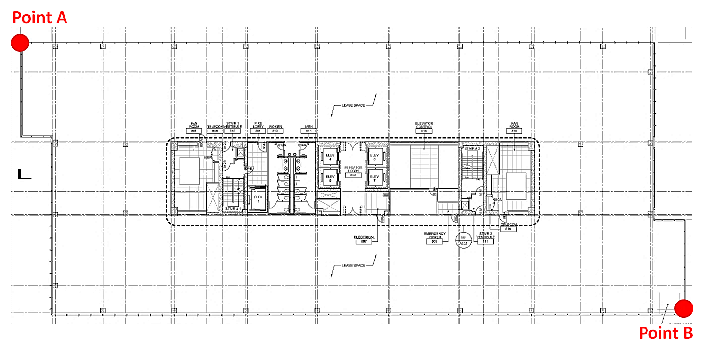
La Jolla Commons Office Tower
Lateral System Verification
Check for Torsional Irregularities X Direction
Level | δ_{A} | δ_{B} | δ_{avg} | δmax | Does a torsional irregularity exist?
PH | 0.6268 | 0.6269 | 0.63 | 0.6269 | No
Level 13 | 0.5762 | 0.5764 | 0.58 | 0.5764 | No
Level 12 | 0.5846 | 0.5847 | 0.58 | 0.5847 | No
Level 11 | 0.5887 | 0.5888 | 0.59 | 0.5888 | No
Level 10 | 0.5877 | 0.5878 | 0.59 | 0.5878 | No
Level 9 | 0.5788 | 0.5789 | 0.58 | 0.5789 | No
Level 8 | 0.5614 | 0.5615 | 0.56 | 0.5615 | No
Level 7 | 0.5320 | 0.5321 | 0.53 | 0.5321 | No
Level 6 | 0.4901 | 0.4902 | 0.49 | 0.4902 | No
Level 5 | 0.4330 | 0.4331 | 0.43 | 0.4331 | No
Level 4 | 0.3582 | 0.3582 | 0.36 | 0.3582 | No
Level 3 | 0.2116 | 0.2637 | 0.24 | 0.2637 | No
Drifts for wind and seismic were verified to meet code and industry standard requirements (Cd=5, R=6)
Torsional analysis was performed at each story under the different seismic load cases and found to no longer have an irregularity
Stability coefficients were verified
Overturning moment was checked under the controlling load case
Appendix List

Slide 66
La Jolla Commons Office Tower
Lateral System Verification
Worst Case Moment for Building Overturning
Seismic Y Direction - Load Case: Y + YET
381110 | ft-k
Drifts for wind and seismic were verified to meet code and industry standard requirements (Cd=5, R=6)
Torsional analysis was performed at each story under the different seismic load cases and found to no longer have an irregularity
Stability coefficients were verified
Overturning moment was checked under the controlling load case
Building Resisting Moment
Worst Case Resistance - Y Direction
Total Building Weight = | 82296 | kip
Moment Arm = | 57.5 | ft
Factory of Safety= | 0.67
M_{resisting} = | 3170446 | ft-k
Check Overturning
Worst Case Resistance - Y Direction
Overturning Moment = | 381,110 | ft-kip
Resisting Moment = | 3,170,446 | ft-kip
Okay? | Pass
Appendix List

Slide 67
La Jolla Commons Office Tower
Vibrations Analysis
Appendix List

Slide 68
La Jolla Commons Office Tower
Vibrations Analysis
LL = 11 PSF
Superimposed DL = 40 PSF
Concrete weight = 50 pcf (Lightweight)
Floor thickness = 5.75”
1.5VLR20 with 4.25” LW topping
P₀ = 65lb
β = 0.03
a₀/g = 0.5%
a_{p}/g = 0.38%
a_{p}/g < a₀/g
Beam Properties:
W_{j} = 153 kip
f_{j} = 4.39 Hz
W_{g} = 205.3 kip
f_{g} = 4.86 Hz
Combined Mode Properties:
f_{n} = 3.36 Hz
W_{total} = 174.5 kip
Appendix List

